Slide 1

Join this livestream…
Hey Class!
join.me/356-493-156
© 2016 | RCB - All Rights Reserved
Notes:
7:00 – 7:05

Slide 2
Down and Dirty CSS
Day 5
Rutgers Coding Bootcamp | February 3, 2016
© 2016 | RCB - All Rights Reserved
Notes:
Start at 6:45 PM

Slide 3
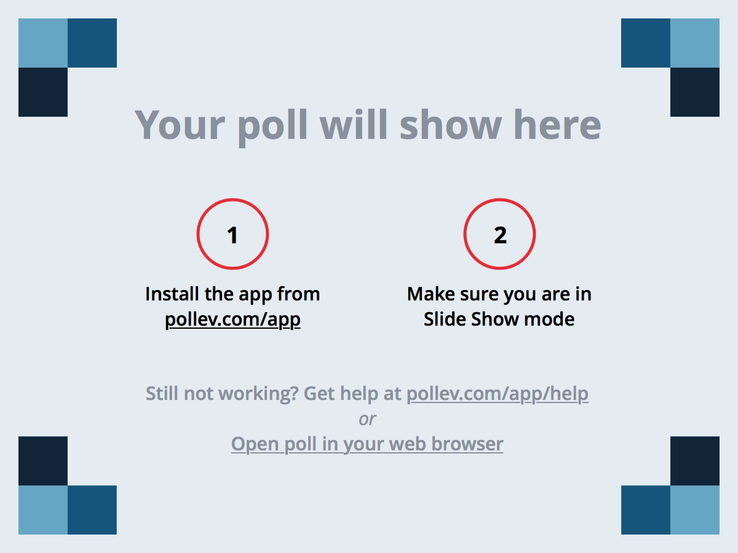
Notes:
Poll Title: Stacey Asks: "What's the best day/time for virtual office hours?" https://www.polleverywhere.com/multiple_choice_polls/6v2oB8qFXoKv9TU

Slide 4
A Few Admin Things…
© 2016 | RCB - All Rights Reserved
Notes:
7:00 – 7:05

Slide 5
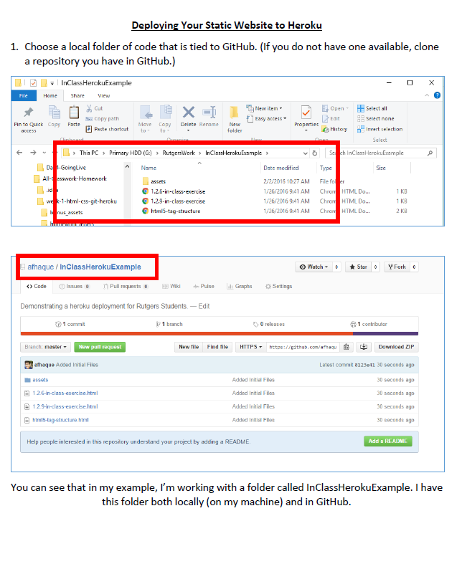
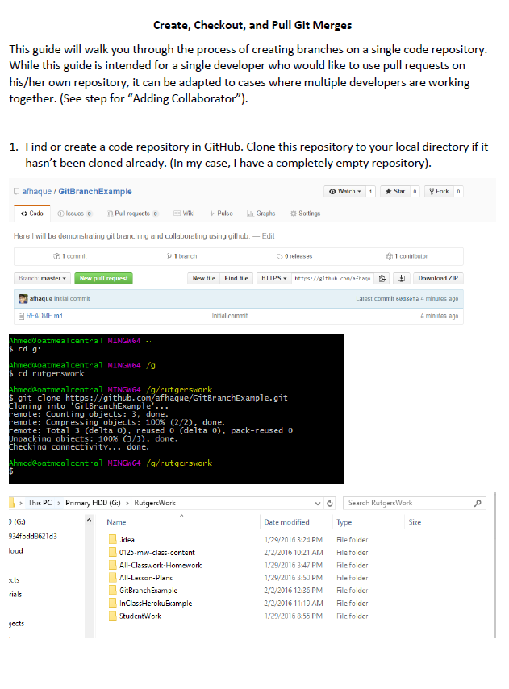

DID YOU GET MAH GUIDES????
© 2016 | RCB - All Rights Reserved
© 2016 | Rutgers Coding Bootcamp - All Rights Reserved

Slide 6
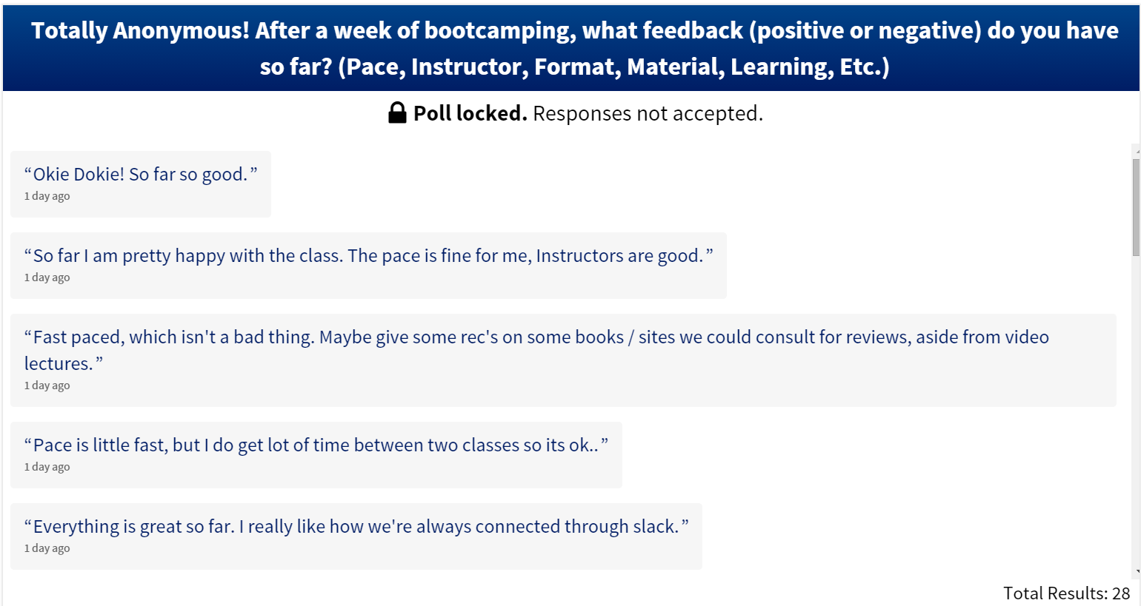
Reviewed Feedback…
© 2016 | RCB - All Rights Reserved
© 2016 | Rutgers Coding Bootcamp - All Rights Reserved

Slide 7
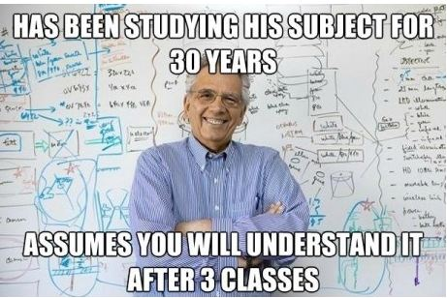
Feedback #1 – Pace is Fast!!!
© 2016 | RCB - All Rights Reserved
© 2016 | Rutgers Coding Bootcamp - All Rights Reserved

Slide 8
Feedback #1 – Pace is Fast!!!
Here’s the reality, the pace of this program is FAST.
We could slow down and make it easier – but that wouldn’t prepare you to be developers right out of the program.
Take up the challenge. Try to retain as much as you can.
Then on your own time (after the program), go back and review the concepts you felt you needed a refresher on.
Don’t try to master every little detail.
Focus on the big picture and how to find what you need, when you need it.
© 2016 | RCB - All Rights Reserved
© 2016 | Rutgers Coding Bootcamp - All Rights Reserved

Slide 9

Feedback #1 – Pace is Fast!!!
That said, as instructors / TAs we are here to help.
As we fall into a class rhythm, I’m going to start incorporating a few 1-on-1 meetings with each of you.
The goal of these meetings is to asses your current abilities, your professional goals, what deficiencies you have, and steps to get on the right track.
These might be before / after class.
© 2016 | RCB - All Rights Reserved
© 2016 | Rutgers Coding Bootcamp - All Rights Reserved

Slide 10

Feedback #2 – Books Please?
© 2016 | RCB - All Rights Reserved
© 2016 | Rutgers Coding Bootcamp - All Rights Reserved

Slide 11
Feedback #2 – Books Please?
Advice: While in this program, concentrate all your efforts on what we’re covering in class.
Books can be helpful when you are learning on your own, but in a bootcamp like this – they can also be distracting, especially when our class is moving so quickly.
When you go home focus all your efforts on trying to re-complete exercises, complete the homework, and going over slides.
Once you are done with the program you can invest in books and outside tutorials.
© 2016 | RCB - All Rights Reserved
© 2016 | Rutgers Coding Bootcamp - All Rights Reserved

Slide 12
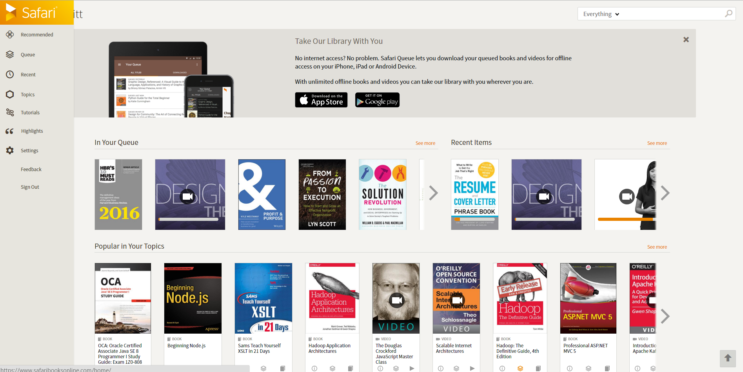
Feedback #2 – Books Please?
Safari Books provides a subscription service to view / download unlimited tech books. This is the de facto place to get software books as the subscription is cheaper than buying single books.
© 2016 | RCB - All Rights Reserved
© 2016 | Rutgers Coding Bootcamp - All Rights Reserved

Slide 13

Feedback #2 – Books Please?
Tuts+ offers a number of high-quality end-to-end tutorials
© 2016 | RCB - All Rights Reserved
© 2016 | Rutgers Coding Bootcamp - All Rights Reserved

Slide 14

Feedback #2 – Books Please?
Code School offers some of the best online courses on HTML, CSS, Javascript, Node, Express, and Angular tutorials of anywhere.
© 2016 | RCB - All Rights Reserved
© 2016 | Rutgers Coding Bootcamp - All Rights Reserved

Slide 15

Feedback #3 – Homework Relevance
© 2016 | RCB - All Rights Reserved
© 2016 | Rutgers Coding Bootcamp - All Rights Reserved

Slide 16
Feedback #3 – Homework Relevance
Going forward, Homework will always be due on Wednesday.
This is to give you additional time to get help via Virtual Office Hours and In-Class Office Hours.
Additionally, every Wednesday, I’ll give you a primer on how to get started on the homework and some general advice on how to avoid snags.
© 2016 | RCB - All Rights Reserved
© 2016 | Rutgers Coding Bootcamp - All Rights Reserved

Slide 17
Today’s Class!
© 2016 | RCB - All Rights Reserved
Notes:
7:00 – 7:05

Slide 18

Our Secret
Shhh!
Today’s “intended” class isn’t “very” important…
Grab as many details as you can, but don’t stress out!
© 2016 | RCB - All Rights Reserved
Notes:
7:00 – 7:05

Slide 19
CSS Typography
© 2016 | RCB - All Rights Reserved
Notes:
7:00 – 7:05

Slide 20
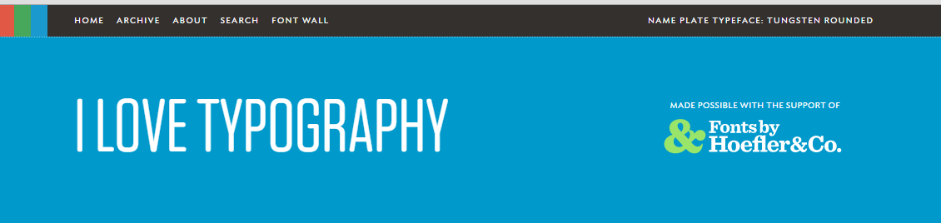
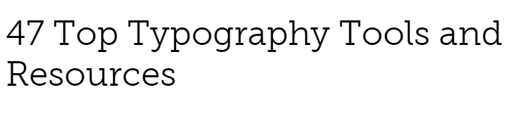

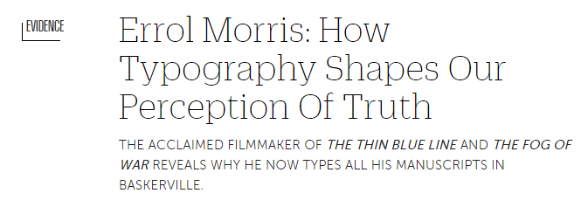
Typography is Huge
© 2016 | RCB - All Rights Reserved
Notes:
7:00 – 7:05

Slide 21

Typography is Huge
Typography can play a huge role in the visual aesthetic and emotional identity of a webpage.
© 2016 | RCB - All Rights Reserved
Notes:
7:00 – 7:05

Slide 22
Typographic Properties
Line Height Distance between lines of text on a page. (Golden Ratio of 1.5x font).
Font-Size Actual size of lettering. Should be at least 16 px on modern pages. https://www.smashingmagazine.com/2011/10/16-pixels-body-copy-anything-less-costly-mistake
Line Length Not a CSS property but rather a standard. Should be about 50-75 characters per line on a desktop http://baymard.com/blog/line-length-readability
Letter Spacing Spacing between individual letters (try to avoid cramping)
San Serif vs Serif Sans-serif (have no line underneath) and are easier to read online
© 2016 | RCB - All Rights Reserved
Notes:
7:00 – 7:05

Slide 23

Line Height vs Fonts
© 2016 | RCB - All Rights Reserved
Notes:
7:00 – 7:05

Slide 24
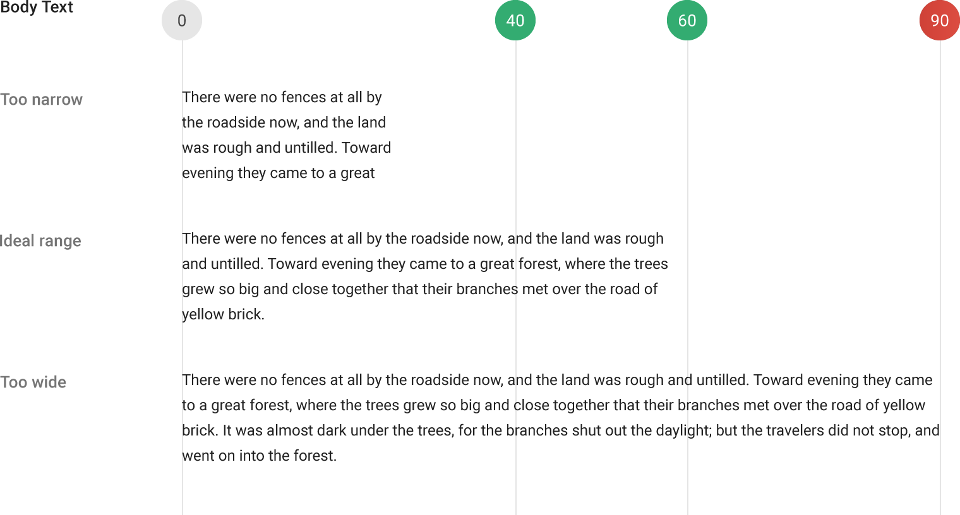
Line Length
© 2016 | RCB - All Rights Reserved
Notes:
7:00 – 7:05

Slide 25

Serif vs Sans Serif
© 2016 | RCB - All Rights Reserved
Notes:
7:00 – 7:05

Slide 26
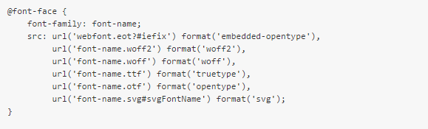
Custom Fonts
Modern CSS allows developers / designers to include their own fonts as part of their webdesign.
This allows viewers to see a website with fonts that their computer doesn’t have installed.
Defining Fonts looks like the below:
© 2016 | RCB - All Rights Reserved
Notes:
7:00 – 7:05

Slide 27
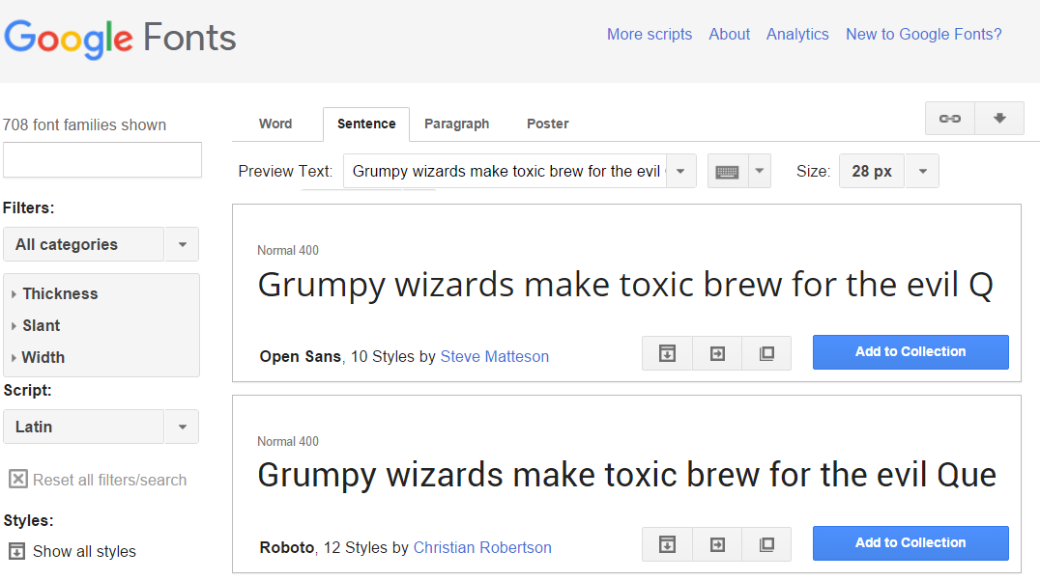
Google Fonts
Google Custom Fonts can be easily incorporated
© 2016 | RCB - All Rights Reserved
Notes:
7:00 – 7:05

Slide 28
> YOUR TURN!!
Assignment
Work through the process of incorporating a custom Google Font into some of your past code. Be sure to incorporate both a serif font and a sans-serif font.
Then proceed through the steps to create a Git branch and create a pull-request on your own code.
Additional details sent via Slack.
© 2016 | RCB - All Rights Reserved
Notes:
Send snapshot from Git command line

Slide 29
Pseudo Styles
© 2016 | RCB - All Rights Reserved
Notes:
7:00 – 7:05

Slide 30
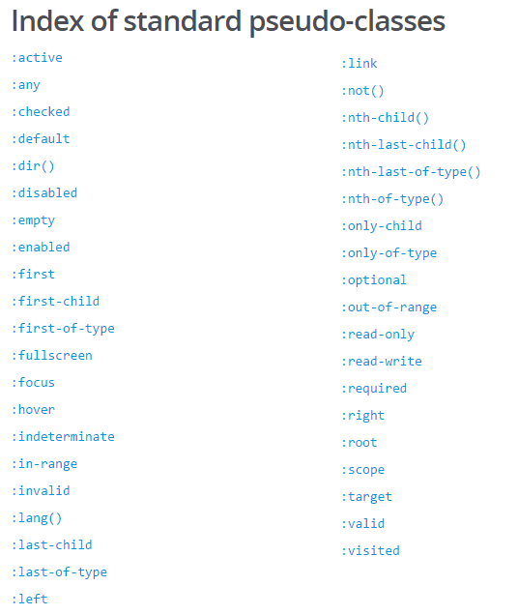
Pseudo Classes
Additionally, CSS has keywords that can be added to selectors to highlight a special state of the element selected.
Great example: CSS can hook onto the specific moment when a link is hovered over using the :hover pseudo-class.
Complete list of pseudo-classes found here: https://developer.mozilla.org/en-US/docs/Web/CSS/Pseudo-classes
© 2016 | RCB - All Rights Reserved
Notes:
7:00 – 7:05

Slide 31
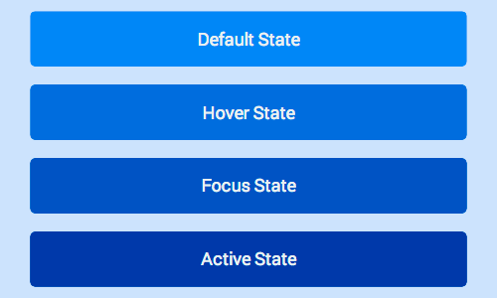
Button with Various States
© 2016 | RCB - All Rights Reserved
Notes:
7:00 – 7:05

Slide 32
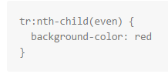
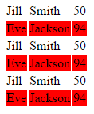
Pseudo Classes
You can even use pseudo classes to target a specific component of a larger element.
Example: Target every other bullet point. Target very other table row a certain way.
Code Snippet See code to the left
© 2016 | RCB - All Rights Reserved
Notes:
7:00 – 7:05

Slide 33
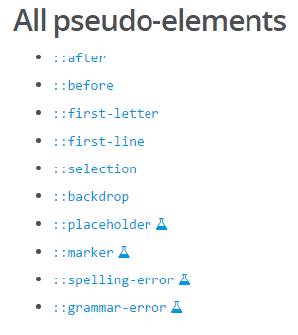
Pseudo Elements
Additionally, CSS has keywords that can be added to style particular parts of an HTML document.
Great example: You can use pseudo-elements to dynamically identify the first-letter or first line. More experimentally you can also use it to style spelling errors or grammar errors a certain way.
https://developer.mozilla.org/en-US/docs/Web/CSS/Pseudo-elements
© 2016 | RCB - All Rights Reserved
Notes:
7:00 – 7:05

Slide 34
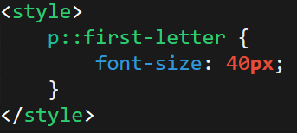
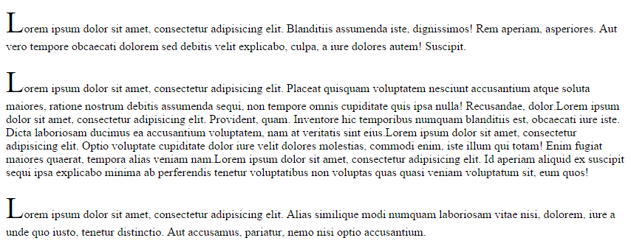
Pseudo Elements
© 2016 | RCB - All Rights Reserved
Notes:
7:00 – 7:05

Slide 35
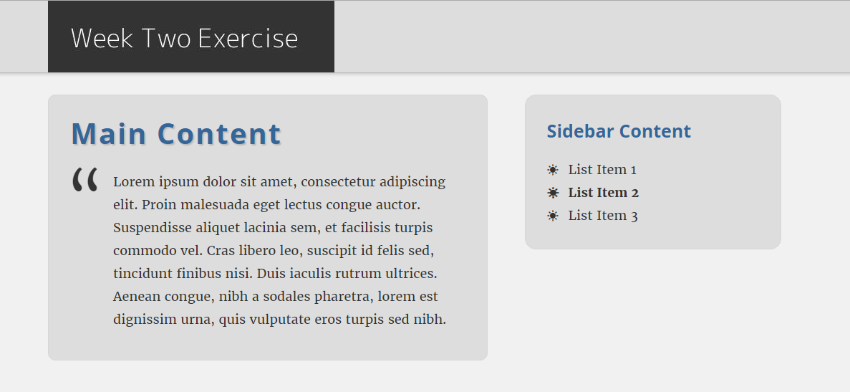
> YOUR TURN!!
© 2016 | RCB - All Rights Reserved
Notes:
Send snapshot from Git command line

Slide 36
> YOUR TURN!!
Assignment:
Make a new HTML document of your choosing (or use one you’ve generated before). Then modify its CSS to use at least 2 CSS pseudo-classes and 2 pseudo-elements in the style sheet.
Post this code to GitHub then slack a screenshot of your creation with a comment listing which pseudo-thingies you used.
© 2016 | RCB - All Rights Reserved
Notes:
Send snapshot from Git command line

Slide 37
Break
© 2016 | RCB - All Rights Reserved
Notes:
7:00 – 7:05

Slide 38
> YOUR TURN!!
Assignment:
Take the code you just posted to GitHub and share the git URL with a partner.
Have your partner modify at least one of the pseudo-elements (or create a new one). Then have your partner create a branch and submit a pull request.
Do the same for your partner’s code as well.
© 2016 | RCB - All Rights Reserved
Notes:
Send snapshot from Git command line

Slide 39
CSS3 Effects
© 2016 | RCB - All Rights Reserved
Notes:
7:00 – 7:05

Slide 40


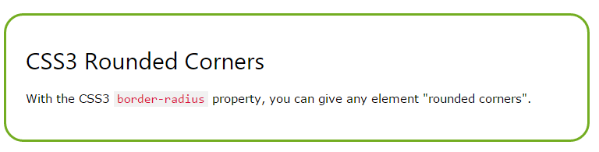
CSS3 Effects
Shadows text-shadow - can be applied to any text element on a page. box-shadow – can be applied to any border box on a page.
Rounded Corners – can be applied to make boxes have curved edges
© 2016 | RCB - All Rights Reserved
Notes:
7:00 – 7:05

Slide 41
> YOUR TURN!!
Assignment:
Take the code you’ve been working on with your partner and apply each of the following on the page:
Text-shadow
Box-shadow
A box with rounded corners
Create a branch and submit a pull-request to your partner when done.
© 2016 | RCB - All Rights Reserved
Notes:
Send snapshot from Git command line

Slide 42
Questions?
© 2016 | RCB - All Rights Reserved
Notes:
7:00 – 7:05

